Slide 1
Support for Various HTTP Methods on the Web
Written by: Sawood Alam, Charles L. Cartledge, and Michael L. Nelson
Presented by Noah Jennings

Slide 2
Introduction
The World Wide Web has evolved in many phases
Lacking a distinct name
No distinct time frame
HTTP (Hypertext Transfer Protocol) was also evolving
CRUD (Create, Read, Update, Delete)
A set of methods was created to perform these
GET, POST, PUT, PATCH, DELETE
Notes:
Evolving created the REST (Representational State Transfer)
Using HTTP methods for appropriate resource actions w/media/relation types in an HTTP communication (REST)

Slide 3
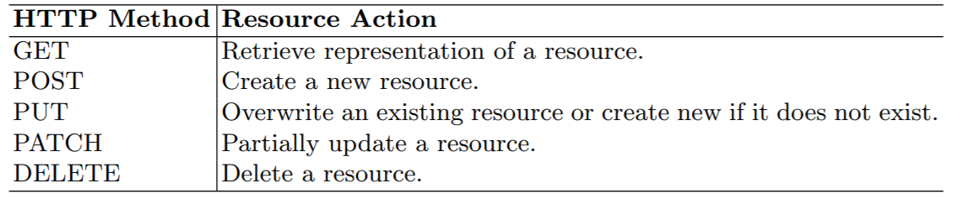
HTTP Methods and Actions
Sawood Alam, Charles L. Cartledge, Michael L. Nelson, Support for Various HTTP Methods on the Web, Technical Report arXiv:1405.2330, May 2014.

Slide 4
Related Issues
Limited web services
Cacheability
Many web services do not support all of the HTTP methods
Calls for extra configurations
Ex
Apache web servers
PUT
Returns 405 Method Not Allowed
Notes:
Limited to a few methods
Repeated methods have an effect that is as if the resource was only made once
Cacheable responses can be stored for later
Non-cacheable methods can cause undesired effects

Slide 5
Investigation
Examine server response on live URI’s
Around 40,000
Discover the capabilities of the server
Pinpoint the HTTP methods supported by the server
Amount supported vs the amount not supported
Notes:
Uri
Uniform resource identifier
Enables interaction with representations of the resource over a network
Changes over time

Slide 6
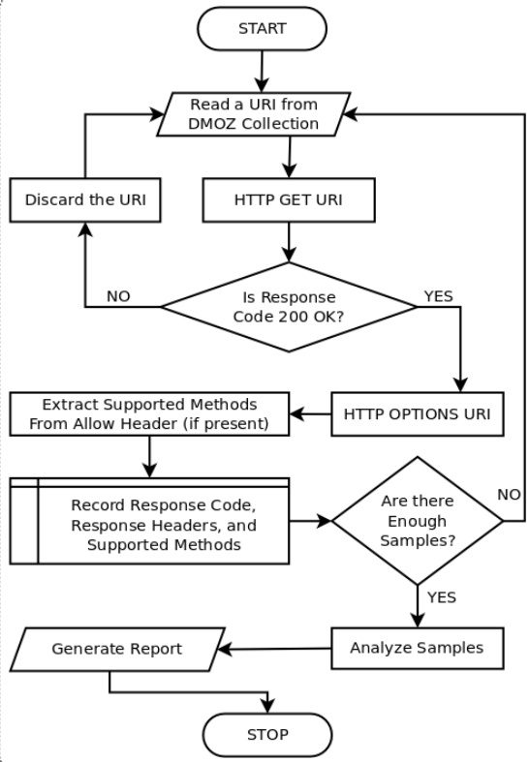
Overview
Sawood Alam, Charles L. Cartledge, Michael L. Nelson, Support for Various HTTP Methods on the Web, Technical Report arXiv:1405.2330, May 2014.
Notes:
Method overview

Slide 7
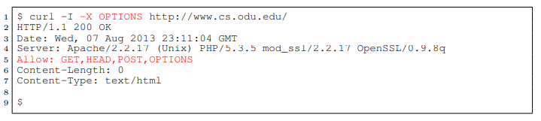
Examination
Issuing OPTIONS request on live URI
Proper implementation below
Returns the methods that are supported by the specific server on the given URI
URI
Server
Sawood Alam, Charles L. Cartledge, Michael L. Nelson, Support for Various HTTP Methods on the Web, Technical Report arXiv:1405.2330, May 2014.
Notes:
Stored for later use
Used to determine the amount of servers with method support
Initially ignored the Top Level Domains (TLD’s)
Path depth of the URI
Must return HEAD 200 OK
40,000 from 100,000

Slide 8
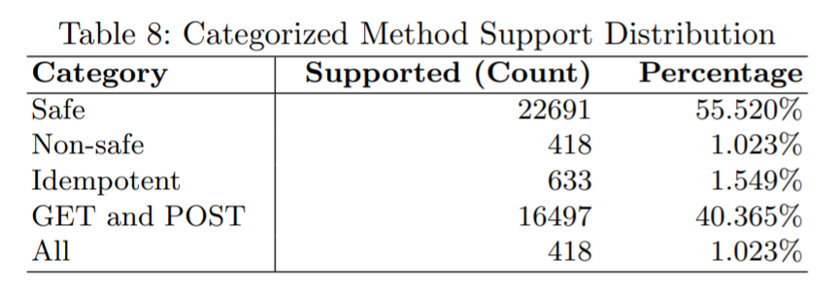
Results
Common methods are grouped together as follows
Safe
Non-safe
Idempotent
GET and POST
ALL
Percentage of used URI’s allowing
the methods
Amount supporting
Method type
Sawood Alam, Charles L. Cartledge, Michael L. Nelson, Support for Various HTTP Methods on the Web, Technical Report arXiv:1405.2330, May 2014.
Notes:
Safe
Retrieve without changing resource state
Head, get, options
Non
Change the state of the resource
Post, put, patch, delete
Idempotent
Multiple requests of the same method appear as if the request was made just once
Non cacheable
Get and Post
Common in RPC (Remote Procedure Call) services
Rely on designers to define their own methods
GET and POST
ALL
Support for all of the 7 most common methods

Slide 9
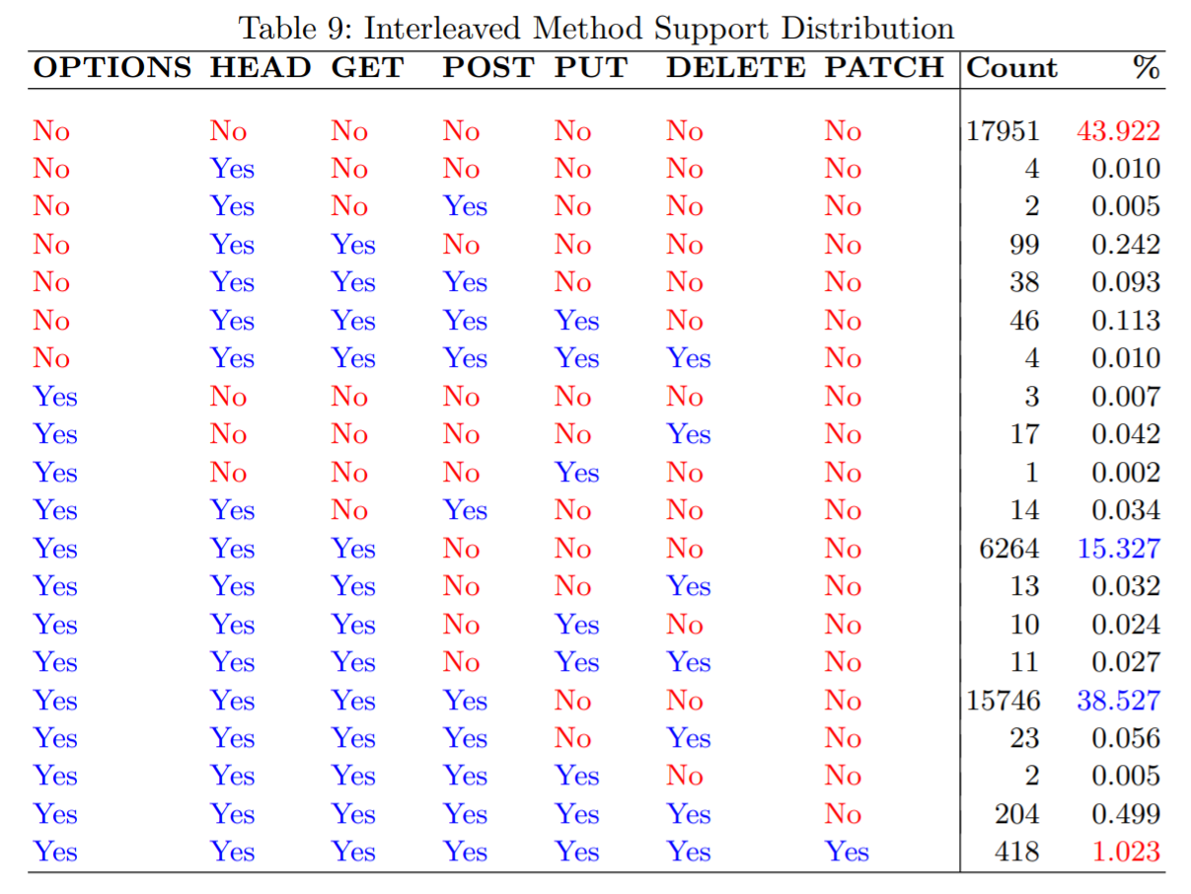
No allow response or no support
OPTIONS, HEAD, GET
OPTIONS, HEAD, GET, POST
All methods
Notes:
Possible method support combinations
Not here? Zero occurrences

Slide 10
Conclusion
~1% of tested URI’s supported all HTTP methods
~44% of tested URI’s had no method support
~55% of tested URI’s supported OPTIONS, HEAD, GET, or POST
Shows need for updated protocol and universality

Slide 11
References
Sawood Alam, Charles L. Cartledge, Michael L. Nelson, Support for Various HTTP Methods on the Web, Technical Report arXiv:1405.2330, May 2014.

Slide 12
Web 0.0
Pre-web
The era when the Internet was developing

Slide 13
Web 1.0
From the invention of the Web until 1999
Static HTML pages connected through hyperlinks
“Read-Only Web”
“Shopping cart and static web” era
Few were responsible for online information

Slide 14
Web 2.0
Collaborative applications emerged
Wikis, blogs, social media platforms
Consumers became producers
“Read-Write Web”
“Read-Write-Publish” era
Increased participation increased the size of the Web
Reduced the gap between consumers and producers

Slide 15
Web 3.0
Began after semantic markup
“Read-Write-Execute Web”
“Semantic Web”
“Semantic Executing Web”
Allowed machines to understand and link information across the Web

Slide 16
Web 4.0
Upcoming Web or the next web
“Read-Write-Execution-Concurrency Web”
“Open Linked, and Intelligent Web”
Machines will:
Consume and understand linked semantic data
Produce information based on learning
Communicate with other machines/resources
“Symbiotic Web”

Slide 17
Web 5.0
An idea in progress
No definition
Devices/machines will
Explore other interconnected devices
Create the model of the Web
Have the component of emotion
“Symbionet Web”

